Slide 1



Compass Software
University of Basrah
College of Engineering
Petroleum Department
Directed By Yaseen Riyadh
20/4/2022

Slide 2
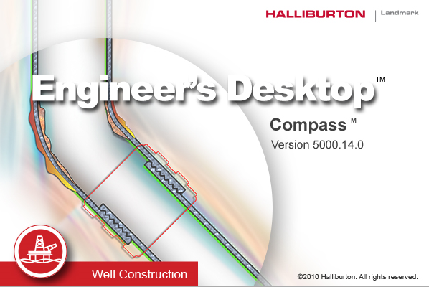

Slide 3
Introduction
COMPASS™ software is the industry's premiere application for directional well path planning, survey data management, plotting and anti-collision analysis. This software, designed for both oil companies and drilling contractors, can improve safety, efficiency and cost effectiveness of directional well programs.

Slide 4
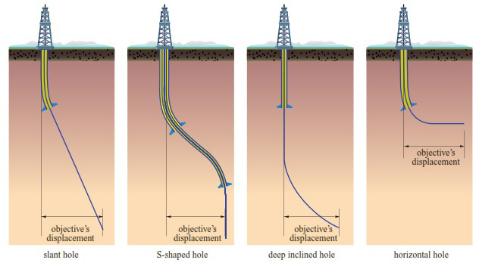
Types of Directional Well Profiles

Slide 5
The Steps were taken in the Workshop

Slide 6
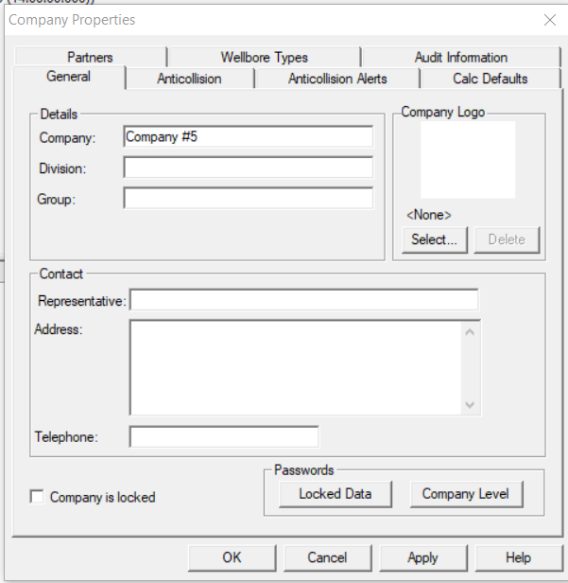
From File – New and then Company

Slide 7
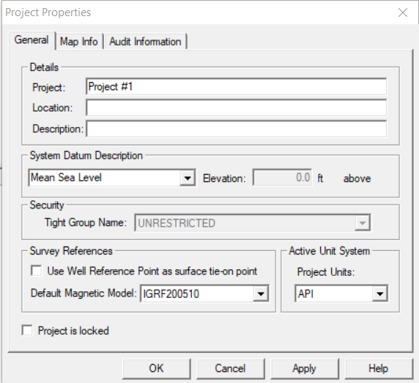
2. After click on ok from the company properties, Click yes to create project

Slide 8
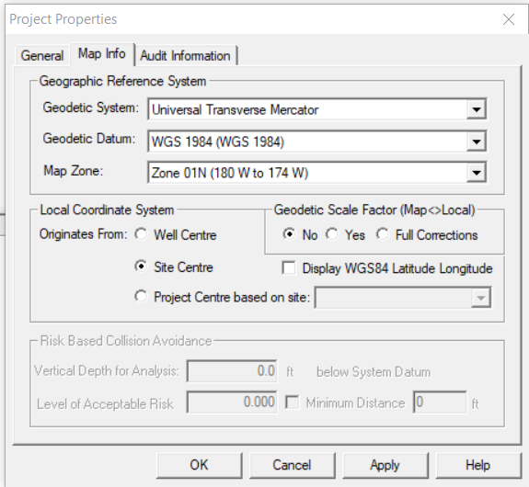
3. Move to Map info

Slide 9
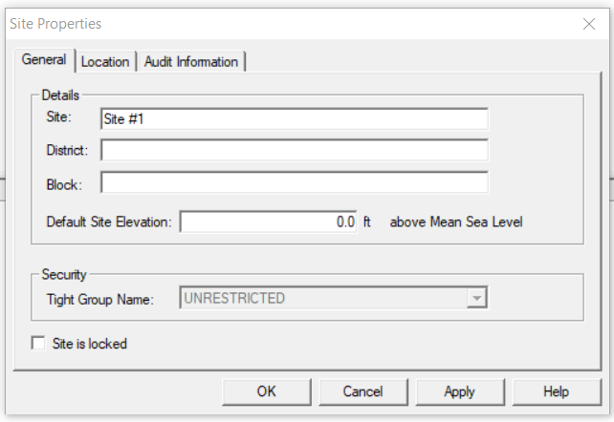
4. Click ok for project properties, Click yes to create site

Slide 10
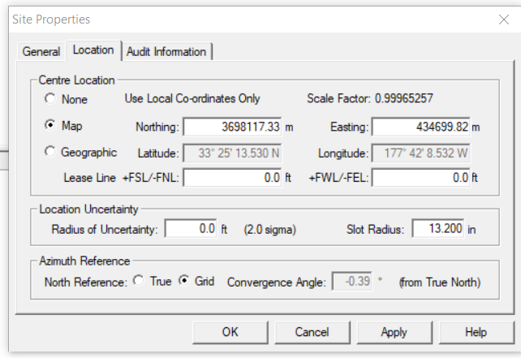
5. Move to Location

Slide 11
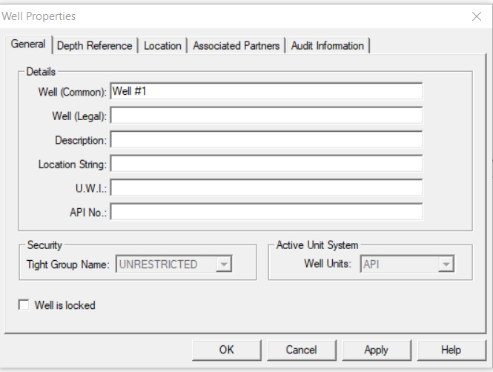
6. Click ok for Site Properties, Click yes to create a Well

Slide 12
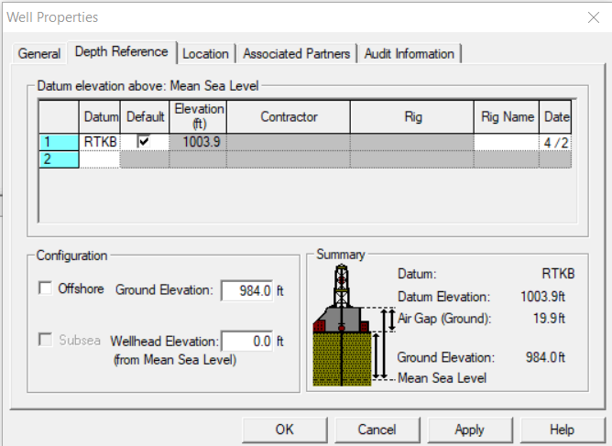
7. Move to Depth Reference

Slide 13
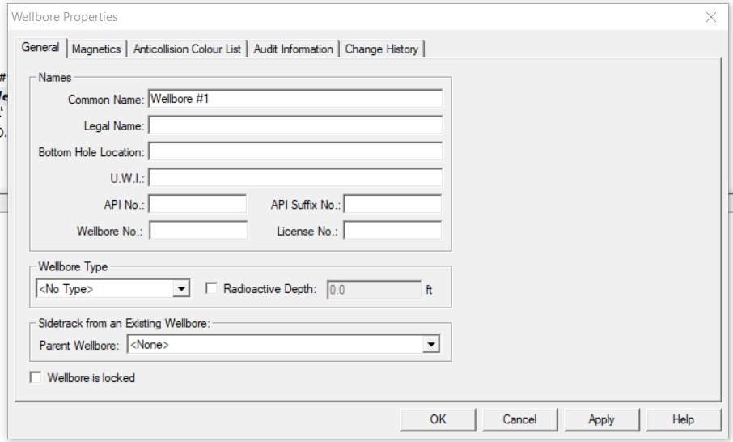
8. Click ok for Well Properties, Click yes to create Wellbore

Slide 14
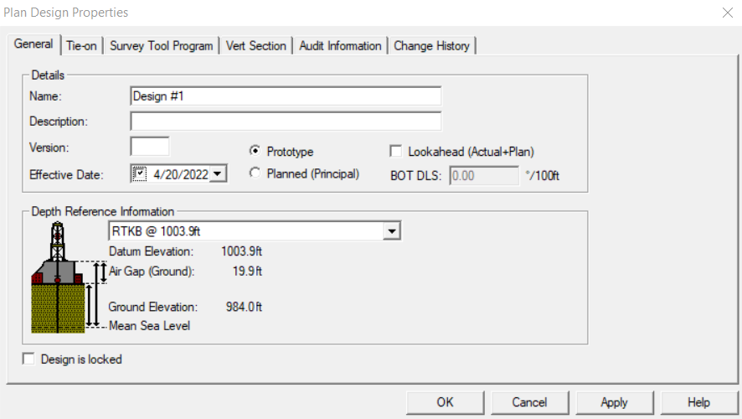
9. Click ok for Wellbore Properties, Click yes to create a Plan

Slide 15
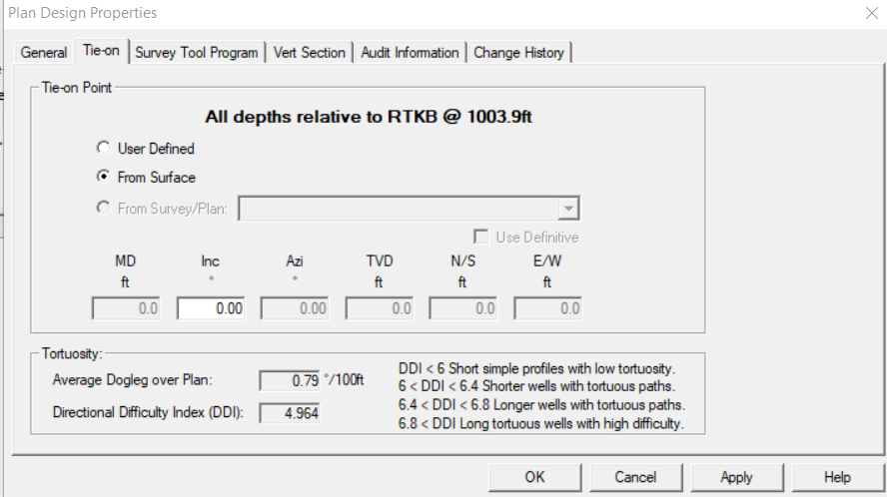
10. Move to Tie-on

Slide 16
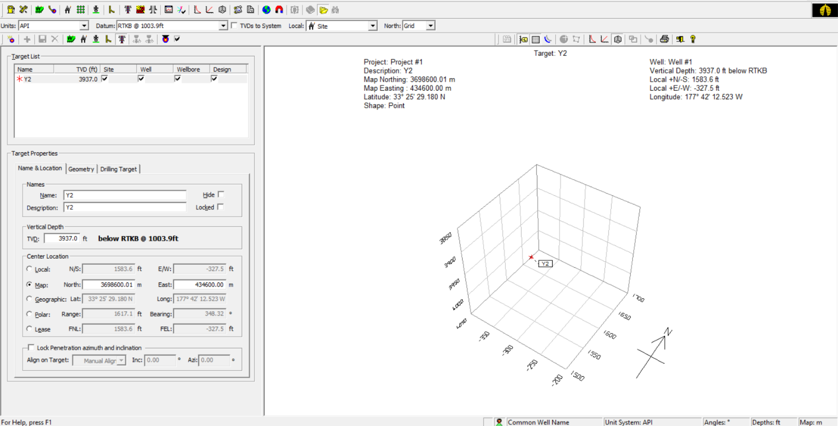
11. From the Target tap, create a Target and then save it.

Slide 17
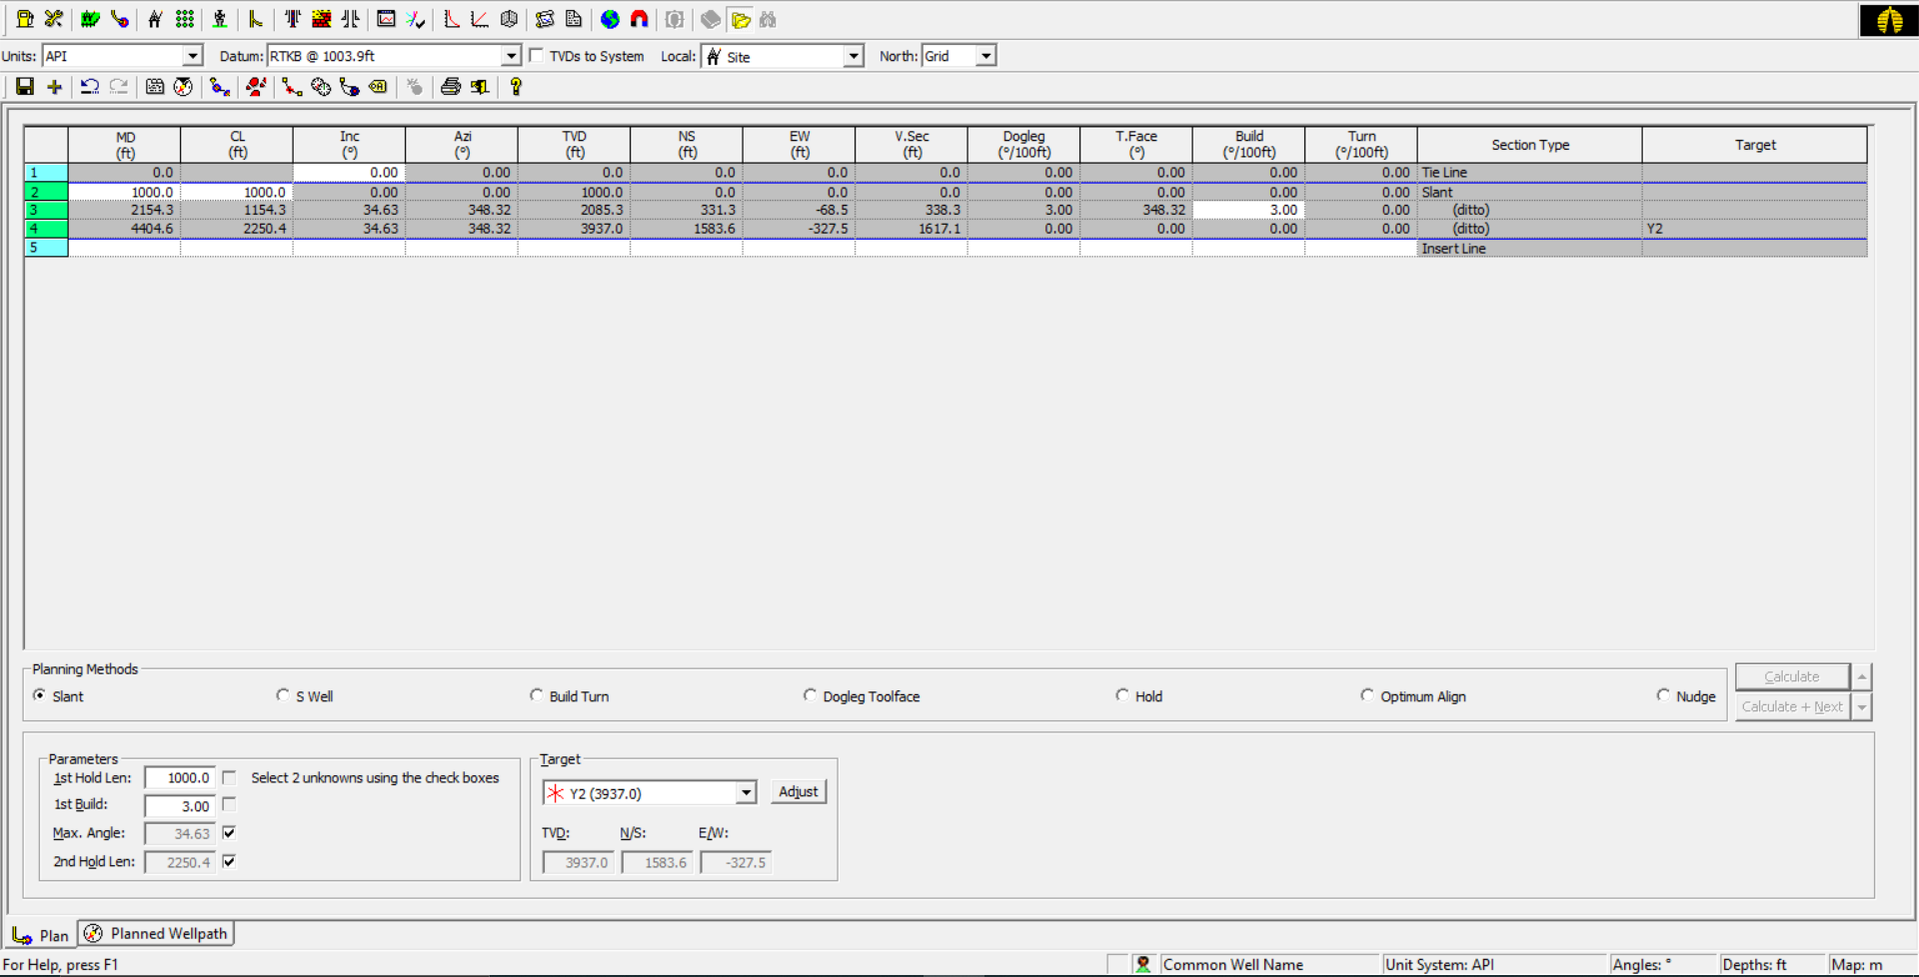
12.
a- From the Design tab, right-click to open the plan,
b- From the Design tab, right-click to edit the Plan Properties
c- Click on Slant (J-shape Well Path Profile), write parameters that specialist with it and then Click Calculate.

Slide 18
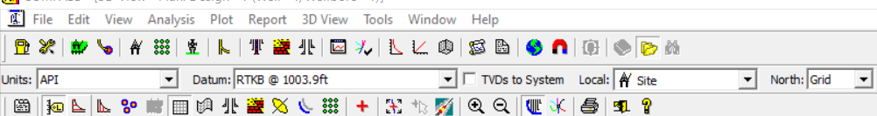
13. After Calculating, From the 3D View tap, to see the J-shape well profile.

Slide 19
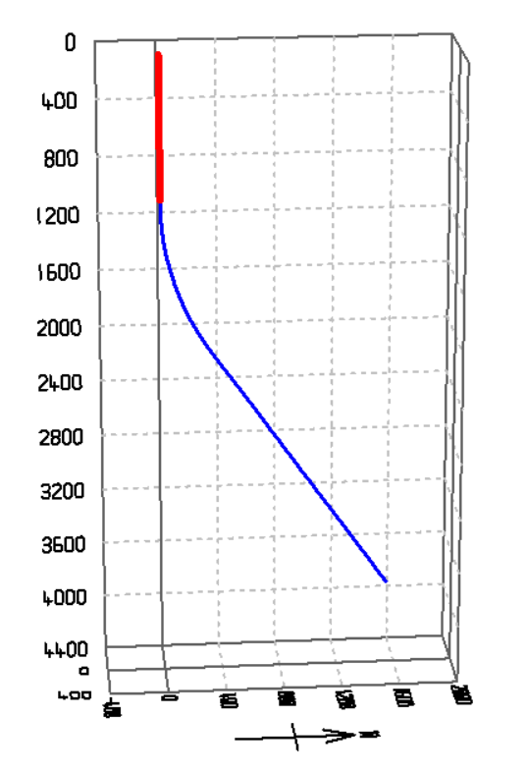
The J-shape well profile.

Slide 20
Thank you

